Slide 1

SEATTLE
With more people working remotely or in a hybrid environment, more offices are vacant. Is there an opportunity for corporations to reimagine these vacant areas and turn them into income generating investments?

Slide 2
PROJECT TEAM ONE
Elizabeth Hansen
Scott McLean
Christopher Lynch
Sheila Troxel

Slide 3
PROBLEM
With many large corporations left with vacant office space post-covid, many are considering requiring employees to return to work. Meanwhile, others are working to create more remote or hybrid options.
How has the COVID-19 pandemic changed the workplace and how can we capitalize on this opportunity to build a workplace of the future?
Our team examined options for corporations to repurpose empty office space by renting space to other commercial business or by providing more rental units to provide housing for individuals moving to the area.

Slide 4
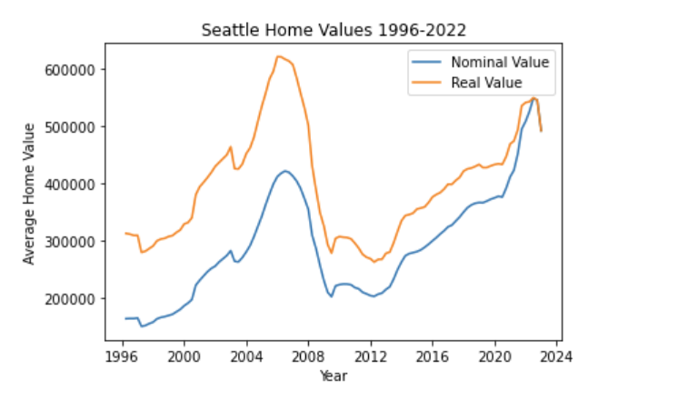
HOUSING REAL ESTATE TRENDS
Housing values in Seattle have been on the rise since 2013, although there has been a recent drop off in housing value
Housing values have not matched there pre-housing crisis real value max of $621,903
Seattle was affected significantly by the housing crisis with homes losing, on average, 50% of there value during the crisis whereas the typical average loss in the united states was between 20-30%
Resources:

Slide 5
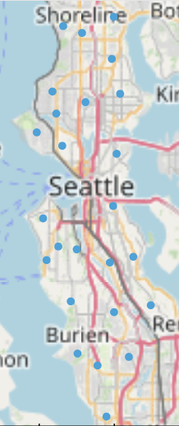
Seattle Housing Cost Analysis by Zip Code
31 zip codes were included in the analysis
Key takeaways:
Average median income: $101,108.03
Average home value: $703,846.88
Average housing to income ratio: 7.09
Average monthly rent: $2,201.81
Average yearly rent to income ratio: 0.27
Average percentage renting housing: 50.47%
Average population: 30,592

Slide 6
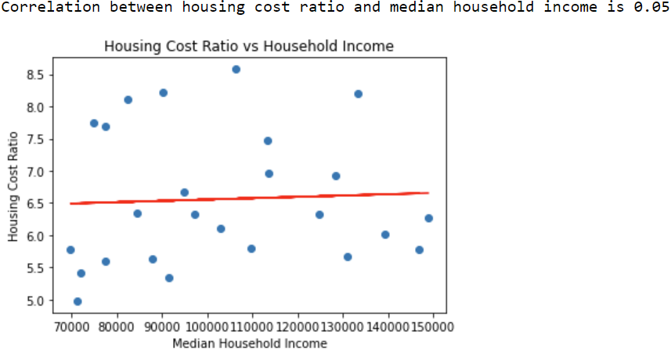
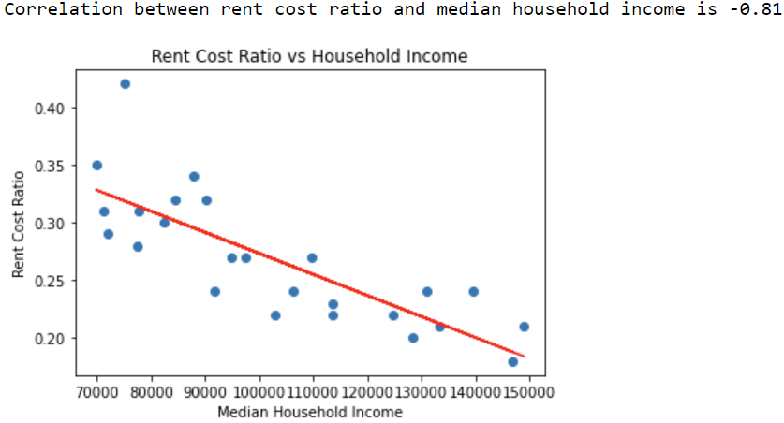
Regression Analysis
Housing values as a ratio of income remain stable across all income levels
Rent cost represent a much larger expense as a percentage of income for lower income households

Slide 7
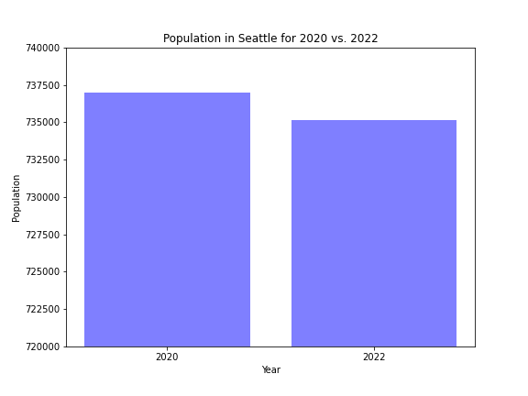
Seattle Population
Comparison between 2020 and 2022
As a result of the option to work remotely in 2022, we have seen a slight decrease in the population of people who live in the city of Seattle, WA. of about 1800 residents.
https://www.census.gov/quickfacts/fact/table/seattlecitywashington/PST045222

Slide 8
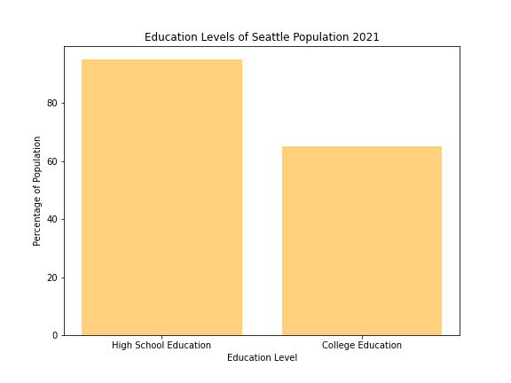
Education and Income
Education Levels of Population
Income
Median household income: $105,391
Per capita income: $68,836
Poverty Rate: 10%
https://www.census.gov/quickfacts/fact/table/seattlecitywashington/PST045222
95.5%
65.9%

Slide 9

Population Employment Data

Slide 10
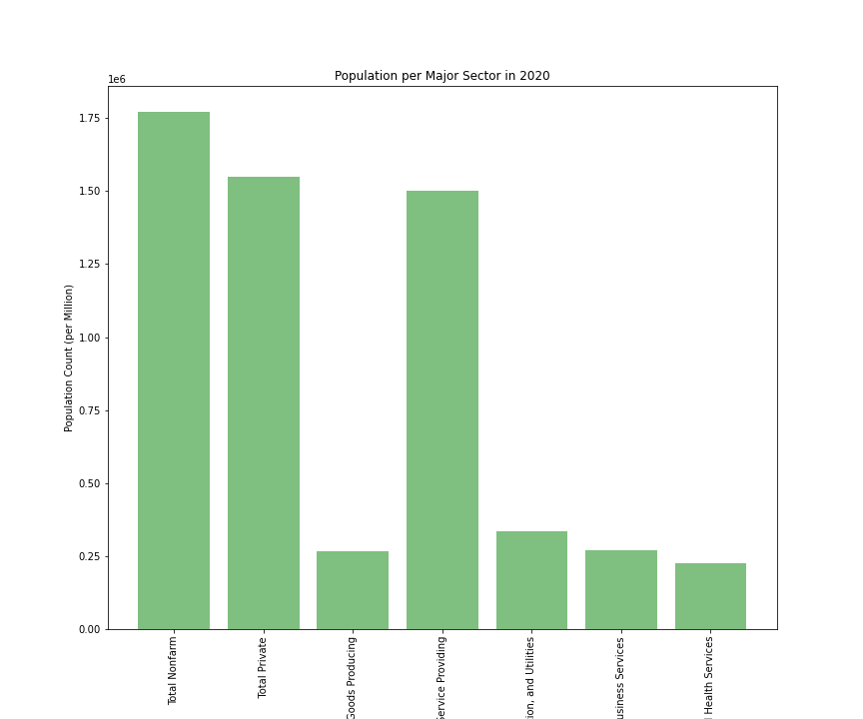
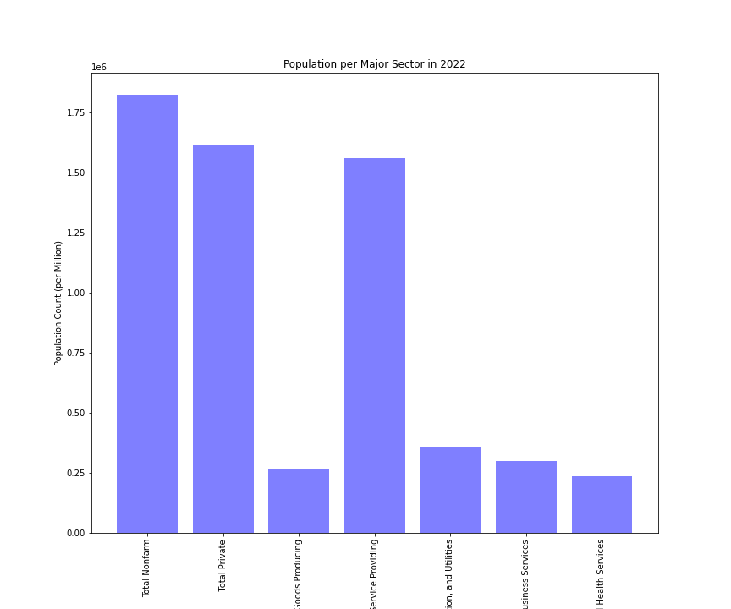
Major Sectors are:
Total Nonfarm
Total Private
Goods Producing
Service Providing
Trade, Transportation, Utilities
Professional and Business Services
Educational and Health Services
These top seven sectors were determined by a minimum of 220,000 persons in each sector
https://esd.wa.gov/labormarketinfo/employment-estimates

Slide 11

Residential vs. Commercial Vacancy

Slide 12
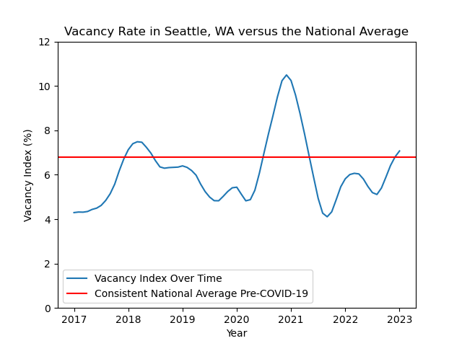
Fig. 1 shows the history of residential vacancies over the past 5 years in Seattle compared to the national average as calculated by ApartmentList.com.
https://www.apartmentlist.com/research/category/data-rent-estimates

Slide 13
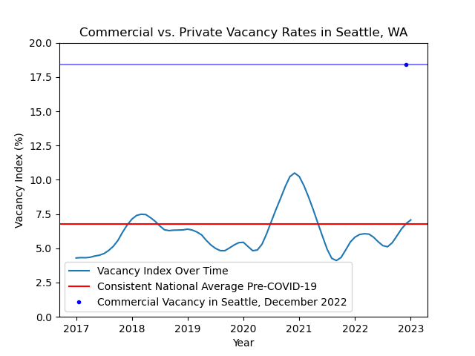
Fig. 2 compares the commercial vacancy rate in December 2022 to the residential vacancy rate.
https://www.commercialedge.com/blog/national-office-report/

Slide 14
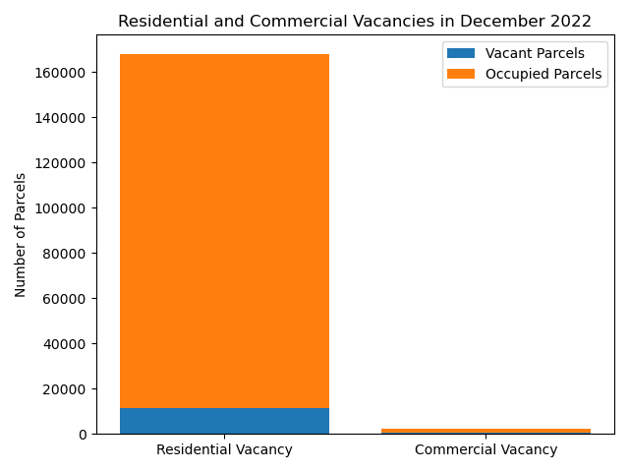
Fig. 2 shows the number of residential parcels as compared to the number of commercial parcels, showing an estimation of vacant parcels to occupied ones.
https://geo.wa.gov/datasets/e8f2df3ed92843738f3dd778e92e93fc_0/explore?location=47.602121%2C-122.308183%2C13.93

Slide 15

Financial Data
We looked at financias from popular corporations headquartered in and around Seattle to examine current debt loads, assets, and more to determine if it would be feasible for companies to invest in repurposing office space.
We looked at 72 different publicly traded companies that included popular ones, such as Amazon, Microsoft, Costco, Nordstroms and more!
Publicly traded companies headquartered in Washington was found on https://wswc.wa.gov/

Slide 16
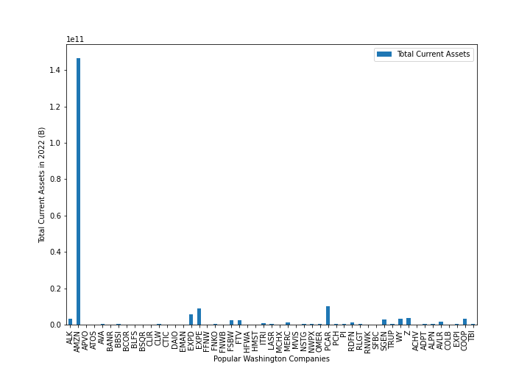
Current Assets 2022
Total Current Assets is the aggregate amount all cash, receivables, prepaid expenses and inventory on an organization's balance sheet.
It is important to look at a company’s total current assets to determine their short-term liquidity and its ability to pay its short-term obligations.
B denotes that the units of figures presented are in billions. We can see in this chart that we have an outlier - Amazon whose numbers are in the billions.
Resources:Data provided by Financial Modeling Prep

Slide 17
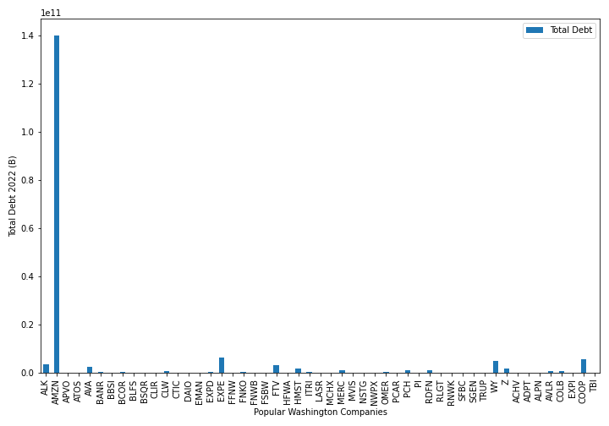
Total Debt 2022
Total Debt is the sum of short-term deb, long-term debit and other fixed payment obligations (such as capital leases) of a business that are incurred while under normal operating cycles.
Similar to how a bank or credit union looks at your debt to income ratio for lending, it’s equally important to look at how companies debt compares to their income.
Total Debt is lower than the Total current assets for many companies show in the chart to the right.
Resources:Data provided by Financial Modeling Prep

Slide 18
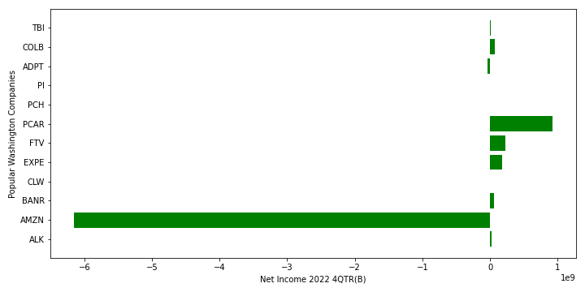
Net Income 2022(4th QTR)
Resources:Data provided by Financial Modeling Prep
Notes:
In grabbing net income for companies, I looked to get data from 4th quarter as they are wrapping up the year. I was able to organize the companies into a dataFrame by year and then by quarter. In doing so it really limited me on data showing me only several companies for 2022. To compare apples to apples, I looked at pulling 2021 data for fourth quarter and my results gave me an empty chart. Financial Data was a challenge to get without subscribing to variously sites. I found Financial modeling as an open sourceware investment financial data and to gather data, I was limited.

Slide 19
Our findings
Housing values in Seattle have been on the rise since 2013, although there has been a recent drop off in housing value, however, it is not substantial.
In 2022, we have seen a slight decrease in the population of people who live in the city of Seattle, WA. of about 1800 residents.
Vacancy rate is only slightly above the national average for residential units but commercial vacancy is significantly higher. This could indicate that more units are needed for commercial use but given the ratio of commercial to residential parcels it may not necessarily be so.
Businesses may be less likely to invest in additional rental space if there is not a great need for rental space.
At this time, we do not have enough data to support a business investment in using vacant office space as rental income.

